Slide 1

Software Engineering
Requirement Engineering -II
Shahbaz Qadeer

Slide 2
Activity Diagram
Activity diagram is basically a flowchart to represent the flow from one activity to another activity. The activity can be described as an operation of the system.
The control flow is drawn from one operation to another. This flow can be sequential, branched, or concurrent. Activity diagrams deal with all type of flow control by using different elements such as fork, join, etc

Slide 3
Activity Diagram(Cont.)
Activity is a particular operation of the system. Activity diagrams are not only used for visualizing the dynamic nature of a system, but they are also used to construct the executable system by using forward and reverse engineering techniques. The only missing thing in the activity diagram is the message part.
It does not show any message flow from one activity to another. Although the diagrams look like a flowchart, they are not. It shows different flows such as parallel, branched, concurrent, and single.
The purpose of an activity diagram can be described as −
Draw the activity flow of a system.
Describe the sequence from one activity to another.
Describe the parallel, branched and concurrent flow of the system.

Slide 4
Activity Diagram (Cont.)
Identify candidate use cases, through the examination of business workflows
Identify pre- and post-conditions (the context) for use cases
Model workflows between/within use cases
Model complex workflows in operations on objects
Model in detail complex activities in a high level activity Diagram

Slide 5
Activity Diagram V.s UseCase (Cont.)
An activity diagram is used to model the workflow depicting conditions, constraints, sequential and concurrent activities.
On the other hand, the purpose of a Use Case is to just depict the functionality i.e. what the system does and not how it is done.
So in simple terms, an activity diagram shows ‘How’ while a Use case shows ‘What’ for a particular system.
The levels of abstraction also vary for both of them. An activity diagram can be used to illustrate a business process (high level implementation) to a stand alone algorithm (ground level implementation).
However, Use cases have a low level of abstraction. They are used to show a high level of implementation only.

Slide 6
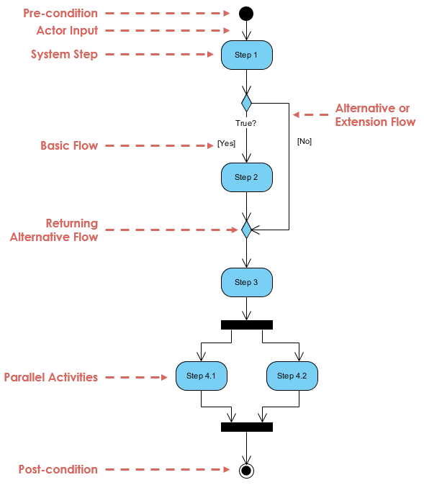

Slide 7
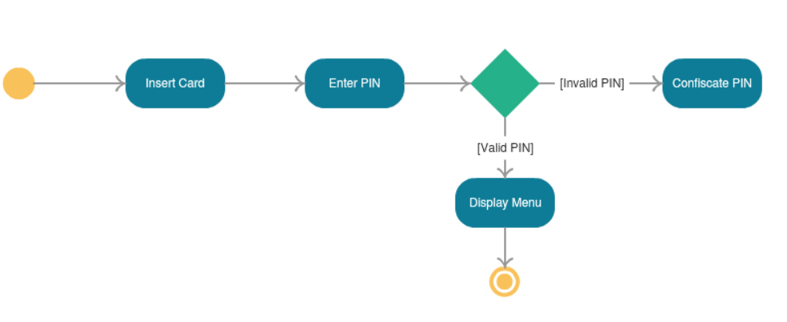
ATM –Pin Verification

Slide 8
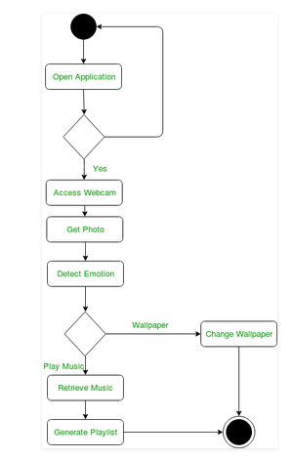
Emotion Based Music Player

Slide 9
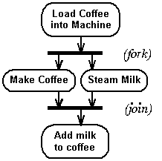
Coffee Machine

Slide 10
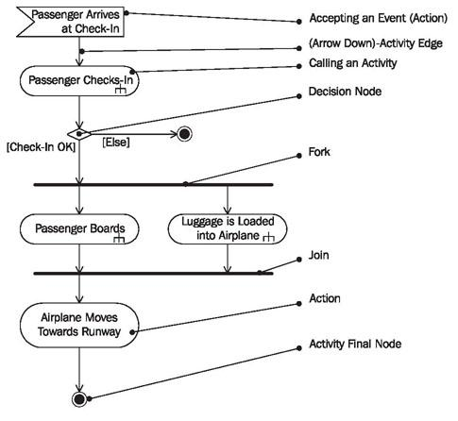
Passenger boarding

Slide 11
Activity Diagram - Modeling a Word Processor
The activity diagram example below describes the workflow for a word process to create a document through the following steps:
Open the word processing package.
Create a file.
Save the file under a unique name within its directory.
Type the document.
If graphics are necessary, open the graphics package, create the graphics, and paste the graphics into the document.
If a spreadsheet is necessary, open the spreadsheet package, create the spreadsheet, and paste the spreadsheet into the document.
Save the file.
Print a hard copy of the document.
Exit the word processing package.

Slide 12
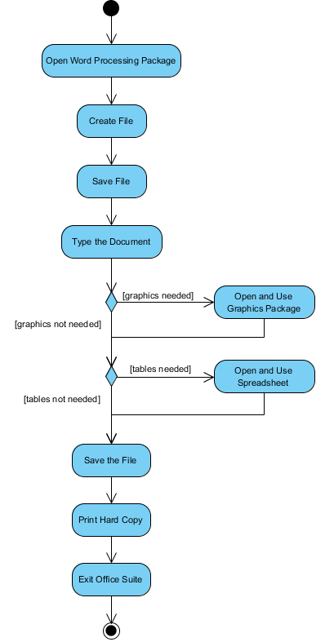
Modeling a Word Processor

Slide 13
Order Management System
Following is an example of an activity diagram for order management system. In the diagram, four activities are identified which are associated with conditions. One important point should be clearly understood that an activity diagram cannot be exactly matched with the code. The activity diagram is made to understand the flow of activities and is mainly used by the business users
Following diagram is drawn with the four main activities −
Send order by the customer
Receipt of the order
Confirm the order
Dispatch the order
After receiving the order request, condition checks are performed to check if it is normal or special order. After the type of order is identified, dispatch activity is performed and that is marked as the termination of the process.

Slide 14
